Slide 1
Smart Stock Inventory Optimization for Retail Stores

Slide 2
Problem Statement & Goals
Problem Statement:
  Retail businesses face losses due to
  Overstock Increased storage & wastage
  Stockout → Lost sales 6 poor customer experience
  Goal:
  Build a predictive model that:
    Forecasts sales per store & product
    Classifies stock as Understock, Overstock Balanced
    Helps retailers maintain optimal inventory levels

Slide 3
TOOLS USED
  build using: ✔️ React + Tailwind CSS
  for UI: ✔️ React Router
  for graphs: ✔️ Recharts / Chart.js
  Backend ✔️ mongo db

Slide 4
Folder structure
smartstock-frontend/
│── src/
│ ├── components/
│ ├── pages/
│ │ ├── Dashboard.jsx
│ │ ├── Products.jsx
│ │ ├── AddProduct.jsx
│ │ ├── Login.jsx
│ ├── App.jsx
│ ├── index.js
│── package.json
backend/
├── models/
│ └── Product.js
├── controllers/
│ └── productController.js
├── routes/
│ ├── productRoutes.js
│ └── chatbotRoutes.js (you already have)
├── server.js
├── package.json
├── .env

Slide 5
pages overview
Login page
Dashboard page
Provides a quick overview of inventory status using cards and charts shows metrics like products, low stock items, and predictions summary
Products page
Displays all products in a table with search and filter options. Allows users to view, edit, or delete existing product entries
A simple and clean interface for users to access the system. Validates user credentials before entering the dashboard
Add product page
A form-based page to add new product details into the inventory helps maintain updated stock and product information
Edit product page
Used to modify existing product data such as price, stock, and category ensures product information remains accurate over time
Predictions page
Shows future demand predications through charts and insight cards recommendes stock adjustments to avoid overstock and stockout situations

Slide 6
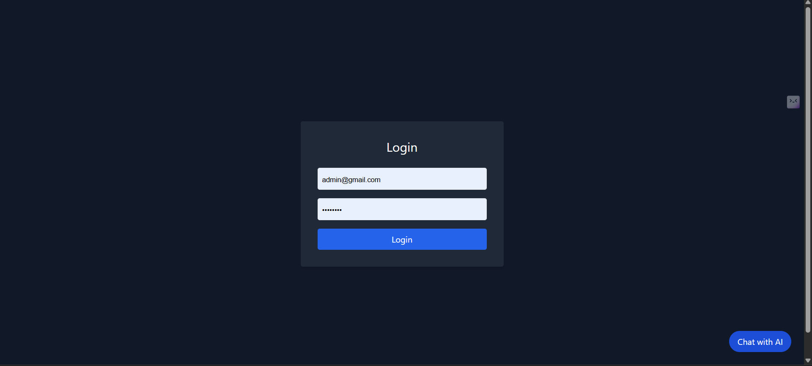
THANK YOU
Login page

Slide 7
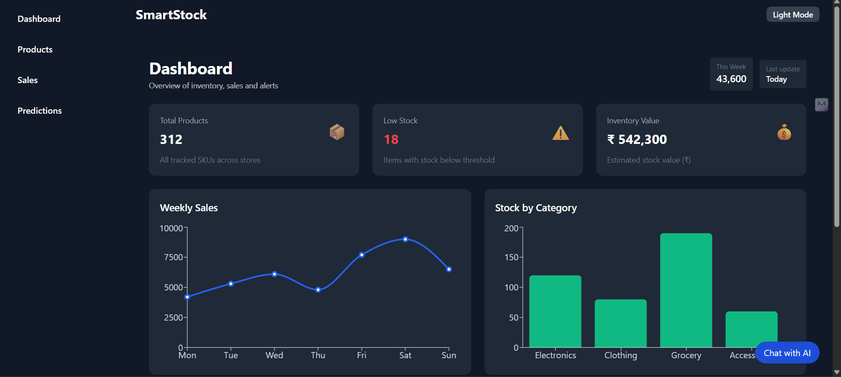
THANK YOU
Dashboard

Slide 8
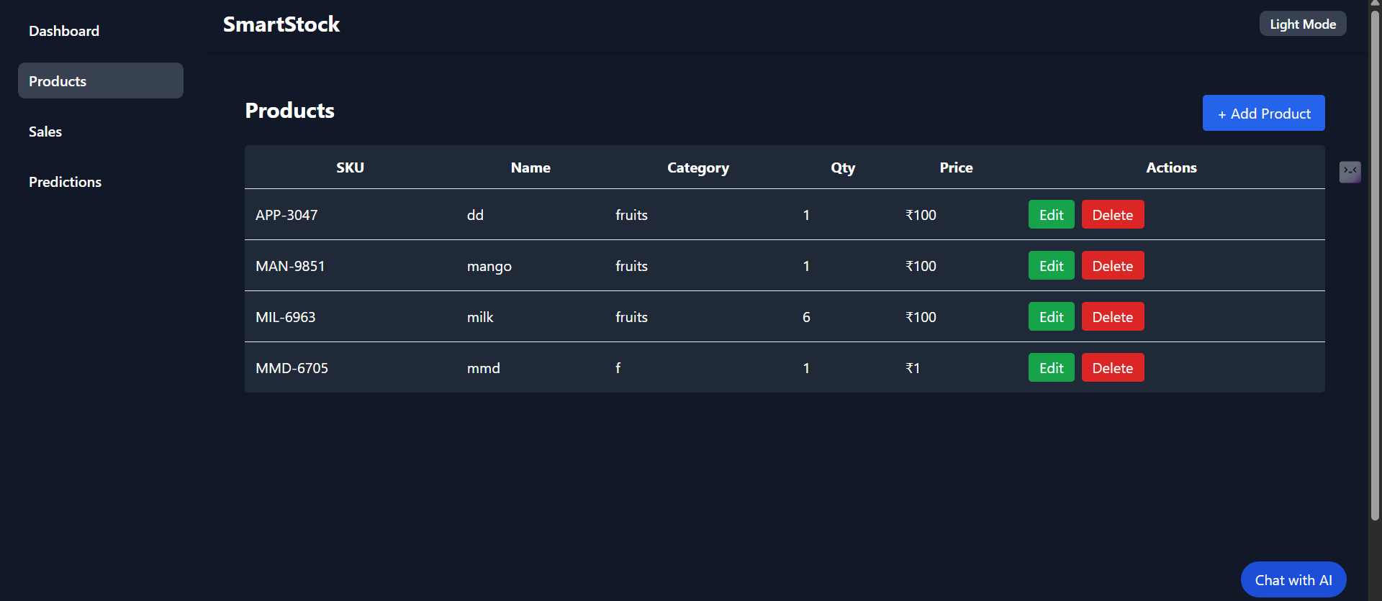
THANK YOU
Products

Slide 9
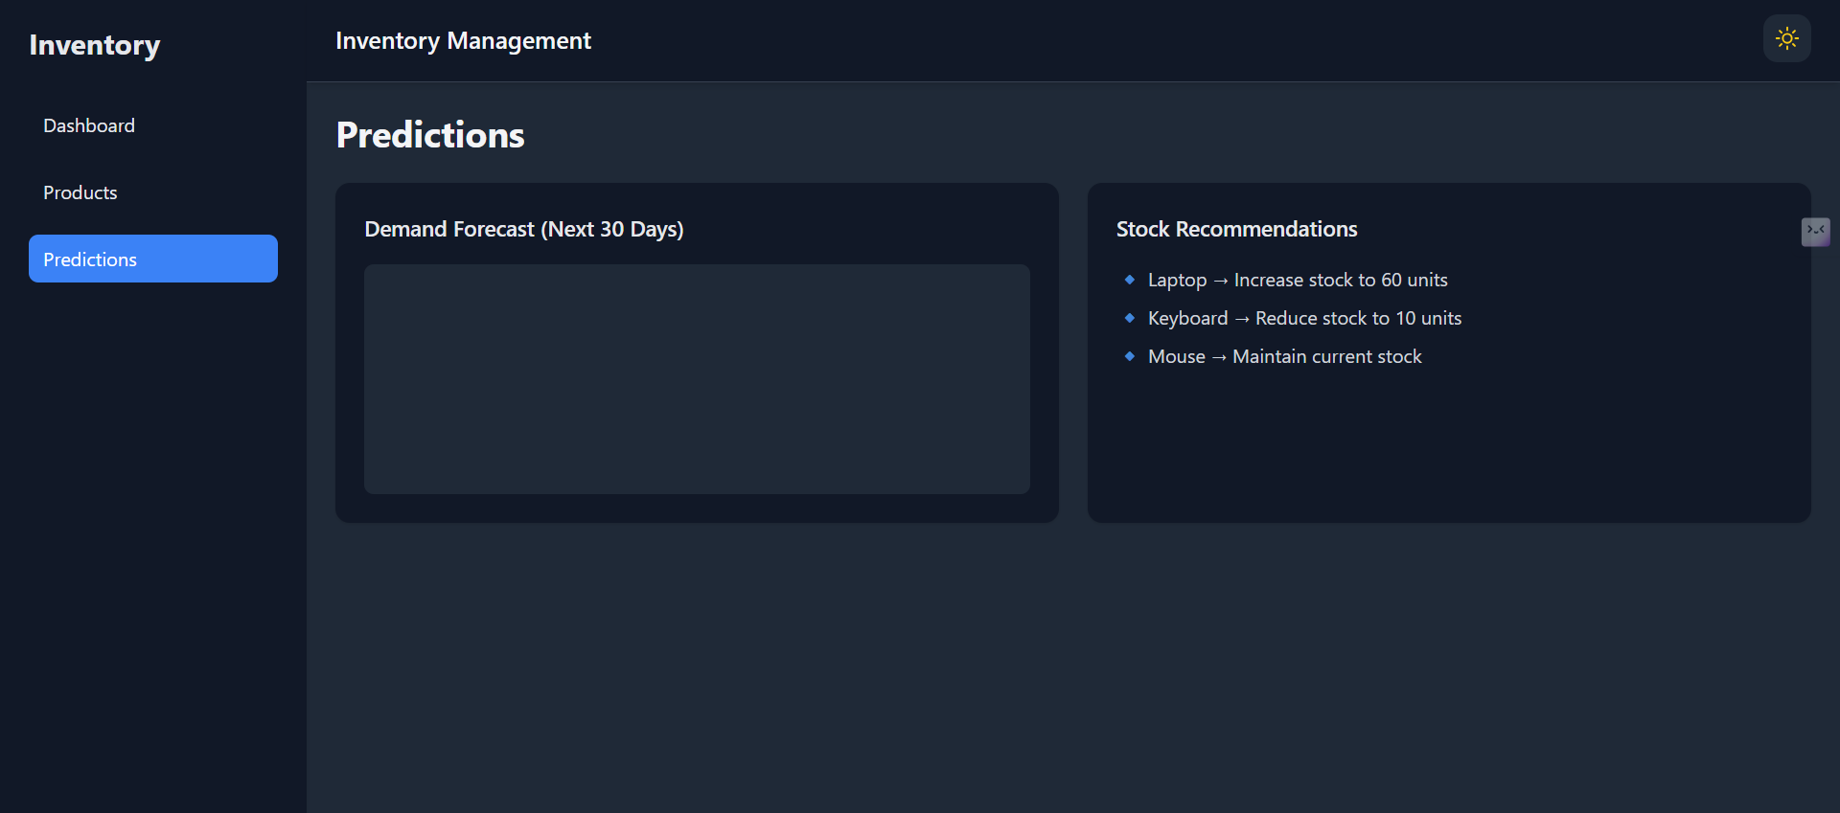
THANK YOU
predictions

Slide 10
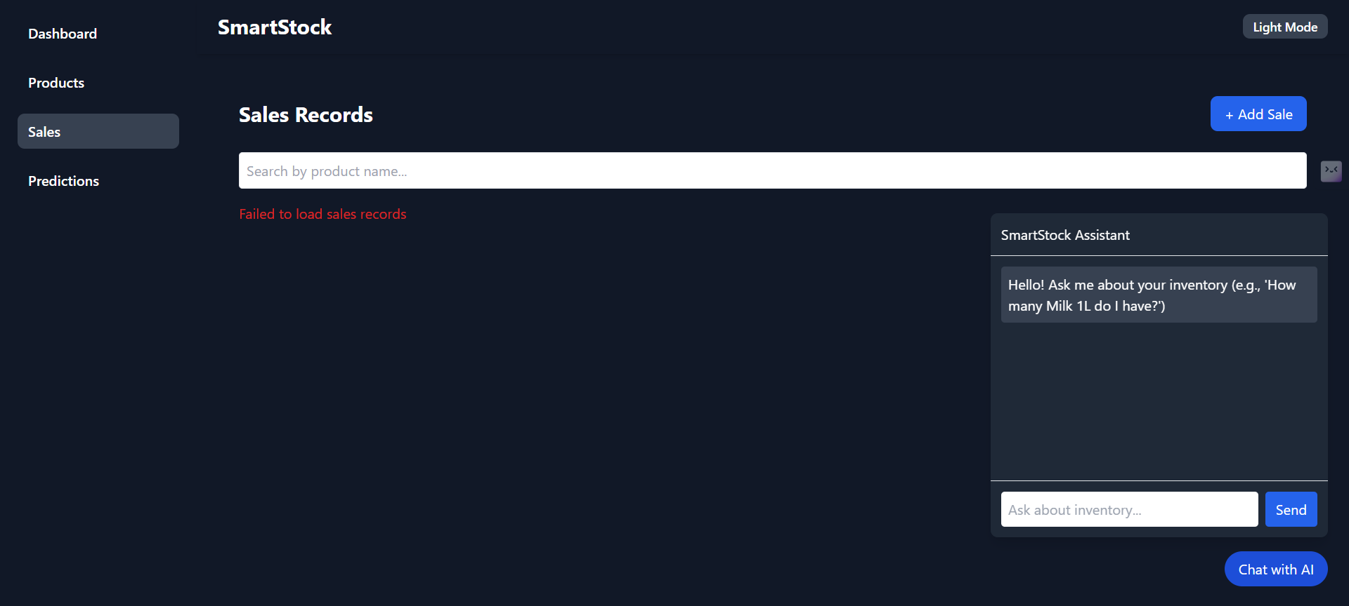
THANK YOU
chatbot

Slide 11
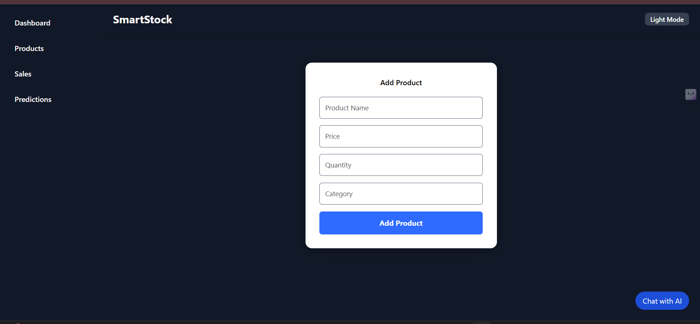
THANK YOU
Add product

Slide 12
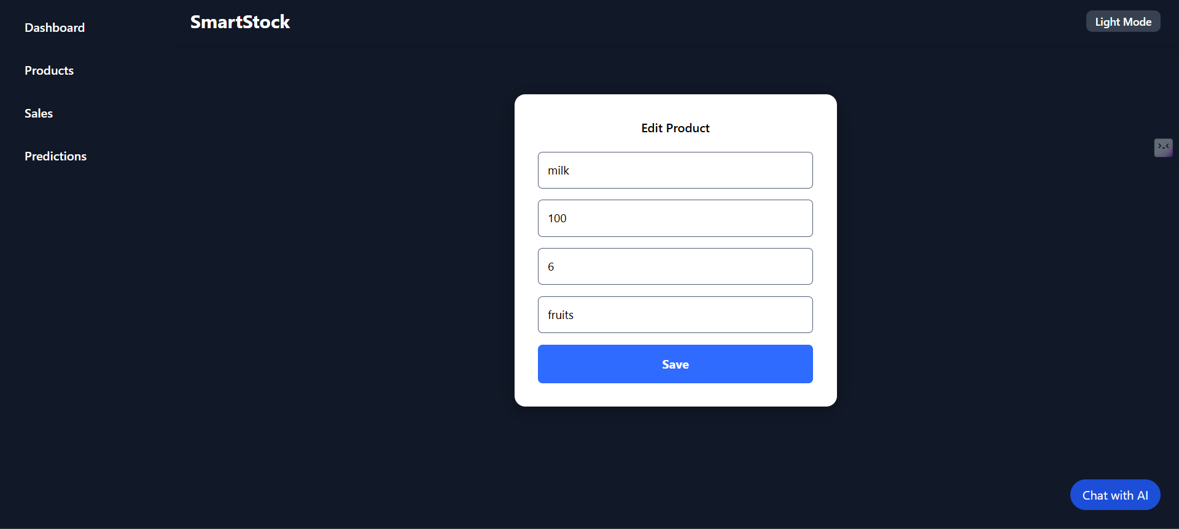
THANK YOU
Edit product

Slide 13
THANK YOU

